Slide 1
Post Secondary Pathways

Slide 2
Startling Statistics on Career Technical Education
Walk around and collect 3 or more estimates related to the fact that you are wearing on your back.
Record them on your index card.
Return to your seat and read the fact you were wearing.

Slide 3
ASCD Policy Priorities – Career Technical Education – Pathways to Post Secondary Success
Percent of U.S. high-school seniors prepared for college math and reading – 37%
Percent in a college prep program with rigorous CTE who are college ready – 80%
Average high-school graduation rate for students concentrating in CTE – 93%
Percent of dropouts who said that relevant, real-world learning would have kept them in high school – 81%
Number of U.S. high-school students currently in CTE classes – 11 million
Percent of manufacturers who report that talent shortages will affect their ability to meet customer demand – 80%
Number of manufacturing jobs currently open – 315,000

Slide 4
ASCD Policy Priorities – Career Technical Education – Pathways to Post Secondary Success
Number of trade, transportation, and utilities sector jobs currently open – 1,019,000
Number of job openings predicted by 2020 – 55 million
Percent of STEM jobs open to workers with less than a bachelor’s degree – 50%
Percent of those jobs that will require some college or a 2-year associate’s degree – 30%
Percent of people with less than an associate’s degree, including licenses and certificates, who earn more than the average bachelor’s degree recipient – 27%
Graduates with a technical or applied science associate’s degree out-earn their peers with a bachelor’s degree by – $2,000-$11,000
The percent of students who complete a bachelor’s degree in four years at most public universities - 19

Slide 5
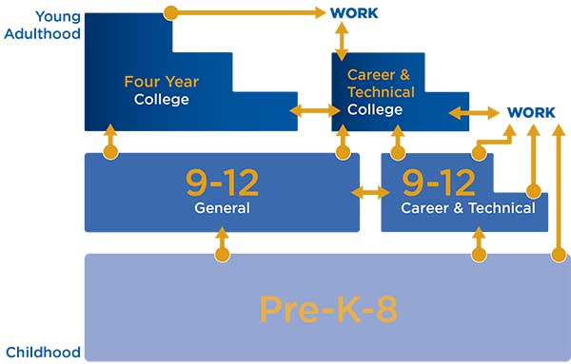
Framing High Schools as Multiple Education Pathways
Once an endpoint – now a stepping stone

Slide 6
Away from Toward Sorting/ranking Post secondary plans for all Compliance Commitment Seat time Relevance School as single Partnerships purveyor of knowledge beyond school walls

Slide 7
Core Principles of Post Secondary Pathways
Pathways keep students’ options open.
The choice of which pathway is up to the student and family.
Pathways are sometimes organized by cohort or academy affording students more personal and academic support.
Integrated curriculum with real application allows for relevance.
Collaboration between the school employers, community partners and post secondary education allow for clear paths.
Authentic bridges exist between high school and paths.
High school is a beginning not an end.

Slide 8
Sample Strategies Based on Evidence Base
Beginning in the freshman year, offer a comprehensive college and career planning program to students and families.
Provide all students support to complete a comprehensive plan for success after high school.
Offer a dual enrollment program that allows student to take college courses for high school AND college credit.
Integration of academic and technical content.
Career awareness, job shadowing, intern and apprenticeships.

Slide 9
How might you like to see high school support your path to adult success?
Student Voices
Click link to play video

Slide 10
Shaping the Path to Support College Access
Shaping Post Secondary Paths
Click link to play video

Slide 11
Promising ideas pick one to explore
Apprenticeships
Community Initiatives
Supports for College

Slide 12
What kinds of experiences are happening in your state that enable students to explore college and career options, develop their talents and passions and deepen their connections to their community? How might we support the design of high schools that help young people envision a future beyond their immediate circumstances and expand their possibilities for students to reach those futures?

