Slide 1
How Do We Communicate What the Evidence-Base for High School Redesign/Improvement is and How it Can be Used to Improve Outcomes to School and District Teams?

Slide 2
Specifically, how can the evidence-base be used to address common challenges of high-needs high schools and as a foundation for local innovation?

Slide 3
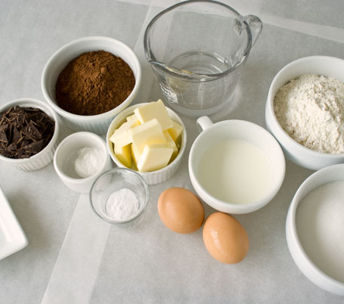
In the Past We Have Communicated Key Elements
Turnaround Principles
Chicago 5 Essentials

Slide 4
We Also Have Descriptions and Images of What Good and Not so Good Practice Looks Like
Global Best Practices
Carnegie Secondary School Design Principles

Slide 5
But Neither of these Has Proven Sufficient for the Highest Needs High Schools

Slide 6
Would an Actual Recipe Help?
Provide guidance on:
Amounts of different elements
Sequence and timing of activities
How to instructions
Variations and substitutions

Slide 7
And/Or to Think About how to Develop the Know How of What is Not in the Recipe
For example, how to balance key tensions.

Slide 8
Tensions to Balance: Organizing Adults and Schools
Safety
Trust
Individual Excellence
Collective Efficacy

Slide 9
Tensions to Balance: Teaching and Learning
Academic Press
Engagement
Demanding
Responsive

Slide 10
Tensions to Balance: Climate and Culture
Authorative
Supportive
Choice and Voice
Structured and Shaped

Slide 11
Navigate Critical Interactions
Achievement
Student Support
High Expectations

Slide 12
Identify the Mental Models that Might Get in the Way of Effective Implementation of Evidence-Based Strategies.

Slide 13
Shifting to Evidence-Based Ideas
FROM
TO
I am not a social worker
Those People
Data for accountability
Punitive
Deficit
Fixed mindset
Mistake bad
Shame
Half-empty pessimism
Compliance
How can I help
We are the people
Data for improvement
Restorative
Asset-based
Growth mindset
Mistake learning
Resilience
Half-Full Optimism
Commitment

Slide 14
Or Cut to the Chase on Focus on Key Drivers of Student Success
Quality coursework, informed by the learning sciences and aligned with college and career ready standards
Equitable Access to Post-Secondary Pathways, Shaping Experiences and Supports
Strong Supportive Relationships between adults and students, adults and adults, and students and students
Continuous Improvement Process embedded in school fabric

Slide 15
It is clear that the high-needs high schools that remain will need help in learning how to bake the cake-turn evidence base elements into a coherent, comprehensive, and integrated set of effective practices.

Slide 16
Why in the CSHSC Approach Goal
Link each participating High Needs High School with a network of similar schools both in-state and cross-state and
Link with technical assistance and implementation support providers who can put implementation support-coaches, facilitators, support staff in the schools to help school implement its redesign plan linked to community goals

Slide 17
Feedback needed on different modalities we are testing to see what is most effective ways to communicate evidence base and the know how to use it to school and district teams
Website-Evidence Says and How and Why to Use Evidence sections
Audiocast on teaming
Video on Student Supports
Mental Model Icebreaker short readings
Forthcoming: two-page summaries and component/interaction maps for each of the four levers of school improvement —
Organizing Adults, Student Supports, Teaching and Learning, Post-Secondary Pathways

Slide 18
Next Steps for CSHSC
Needs Assessment
Community Input Tools
Common On-Track to Success Metrics for Participating Schools
Pilots in Some States

Slide 19
Questions and Thoughts

