Slide 1
Extending Early Warning Systems to College and Career Readiness: The CRIS Initiative October 21, 2014 Middle School Matters Fall Summit Dallas, Texas Angela Romans, Annenberg Institute for School Reform Linda Johnson, Dallas Independent School District
Supported by the Bill & Melinda Gates Foundation
Notes:
NOTE: SUB-TITLE RIGHT? NEED TO ADD PRESENTERS NAMES/AFFILIATIONS
Extending EWIS to College and Career Readiness: The CRIS
framework and practice

Slide 2
Session Goals
Present context, framework and lessons from College Readiness Indicators System (CRIS) Initiative
Describe practical tools and resources generated through this work
Highlight innovations in local college and career readiness capacity produced by civic partnerships
Notes:
NOTE: CUSTOMIZE FOR TEACHING SUMMIT
***
So as the agenda says, I’m here to talk with you about a project my colleagues and I have been working on for the past four years called the College Readiness Indicator Systems Initiative (what for obvious reasons we’ve shortened to the acronym, CRIS). We just completed the pilot phase of work in five districts and have been harvest and product development mode for the past nine months or so. And now we’re eager to share some of these resources and approaches with other districts and education reform networks like yours.
So over the next 20 minutes or so I’ll be walking through the basic framework of CRIS, what we think is new about, Share some of the lessons and tools. And then close with a few examples of innovations – I chose these specifically because they are the work of partnerships (including local funders) and in all cases included involvement of higher education – which I know is an interest of this group. So I hope these approaches resonate and provide a jumping off point for our discussion.

Slide 3
Context for College Readiness Initiative: Recent Trends in Educational Attainment
HS Graduation
College Enrollment
College Completion
4 Year
College Completion
2 Year
Source: National Center for Education Statistics
Notes:
NOTE: THIS FIGURE BRINGS IT HOME FOR THE AUDIENCE. WOULD WANT TO CHECK TO SEE IF THIS IS MOST RECENT AND RELIABLE DATA AVAILABLE.
***
What’s fueled all the attention on college and career readiness over the past 7 of 8 years is the good news/bad news contrast you see in these trend lines.
I’ve always wanted to put this story on one chart. But there are interpretation challenges. HS graduation and college enrollment rates have climb; college completion rates have been stuck at fairly low levels. What more can be done to improve college completion rates?
This readiness business can quickly get very academic and technical so I think it’s important to put a face on this which Paul Tough does better than almost anyone. Who happen to catch the story in the NYT magazine about a month ago –Who Gets to Graduate.This is really a story within a story. The protagonist is a young woman named Vanessa Brewer. For those of you working with high achieving kids in high poverty schools it’s a familiar one: She graduated in 2013 from Mesquite High School in suburban Dallas (working class bedroom community of Dallas). Solid academic credentials – 3.5 GPA, top 10% in a class of 600, 22 on ACT (not fantastic but “college ready” in the estimation of the test developer). She was accepted at the UT Austin failed a couple of exams and really began to doubt her decision. Maybe I should have started at the community college. That overwhelming self-doubt and fear drives those bottom two trend line. Tough concludes: “it’s not enough to deal with their academic and financial obstacles, you also need to address their doubts and misconceptions and fears. Stars: UT-Austin professors.

Slide 4
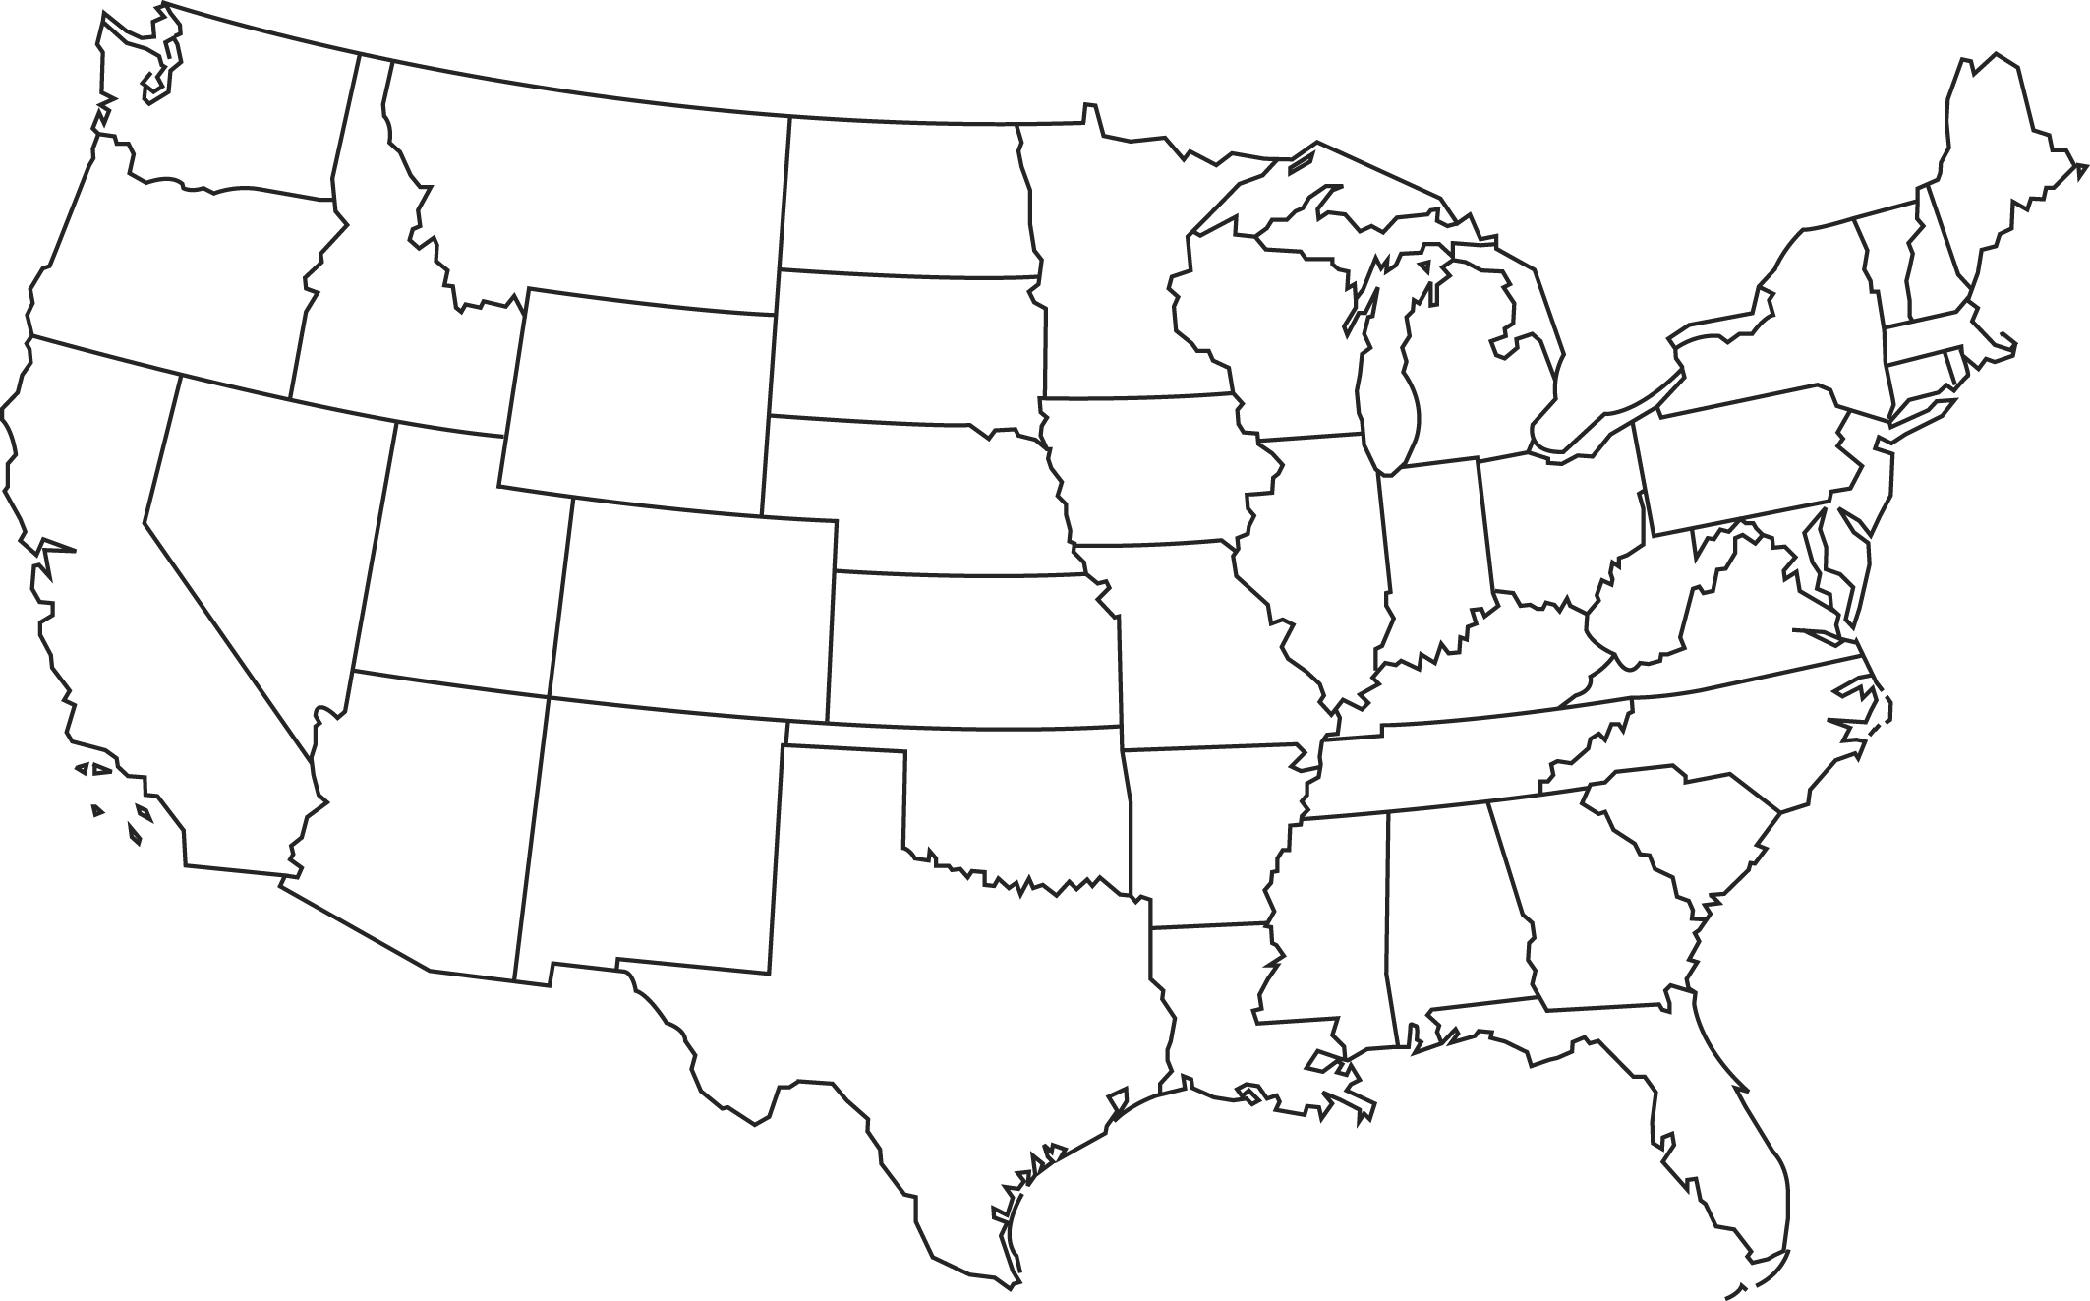
Five CRIS Sites
New Visions for Public Schools (NYC)
Pittsburgh Public Schools
School District of Philadelphia
San Jose Unified School District
Dallas Independent School District
Notes:
NOTE: OK
***
And that was basically the impetus for the CRIS Initiative and many college access projects like it.
About four years ago the Gates Foundation brought together a number of research organizations that were working on the college and career readiness. Three research support organizations – Annenberg, JGC and the UCCSR, Hopklns.
Identified five districts that were in the vanguard of the college readiness or data-informed decision making movements. The Foundation’s investment rationale was with technical support, peer learning and financial resources (modest grants) – we could incubate some promising practices and practical tools in using indicator data to provide students with timely supports they need to graduate high school and be ready to succeed in post-secondary training.
Our four districts (SJ, Dal, Phil, Pitt and one Partnership Support Organization (New Visions for New Schools)

Slide 5
College readiness is multi-dimensional
Coursework, skills, and achievements needed to succeed at college-level work
ACADEMIC PREPAREDNESS
Beliefs, motivation, attitudes, and behaviors needed to successfully engage with academic challenges and college-going goals
Knowledge, skills, and behaviors needed to access college and successfully navigate its demands
COLLEGE
KNOWLEDGE
ACADEMIC TENACITY
Notes:
NOTE: OK
***
What’s different about the CRIS approach? Two things:
Equal attention to three dimensions of readiness – the traditional academic, the social/emotional learning (tenacity/grit), practical skills and knowledge needed to gain admission to the right college and successfully navigating once there.
Builds on the research of David Conley and others
These is often where the question comes up – If 66% enroll in college the fall following graduation, what about the other 34% (1.1 m in 2012)? College-ready is translated as ready to pursue, without remediation, formal post-secondary training – non-degree credential, military service, apprenticeship in trade union, and the like. I think you’ll find these indicators parallel in many ways the 21st century skills --

Slide 6
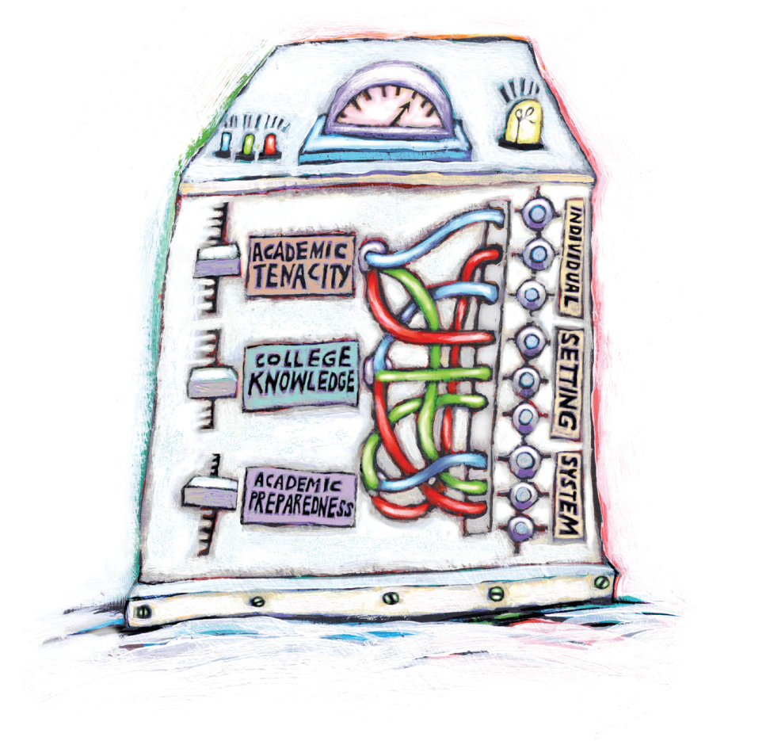
A tri-level approach
Individual (student)
Setting (school)
System (district and partners)
Goal: generate actionable knowledge at all three levels
Notes:
NOTE: OK
***
Second difference:
Traditionally college readiness has been about getting individual students the supports and interventions they need to stay on track.
What CRIS does is reveal specific responses that can be taken at two other levels of analysis
Schools (culture and organizational practices)
System (resources, policies and partnerships)
Inputs and outputs
What results is a 3 x 3 matrix with dimensions of readiness on the y axis and levels on the x

Slide 7
Sample indicators from the CRIS Menu
 | INDIVIDUAL-LEVEL INDICATORS | SETTING-LEVEL INDICATORS | SYSTEM-LEVEL INDICATORS
ACADEMIC PREPAREDNESS (AP) | GPA ➔ | Consistent grading practices ➔ | Alignment of HS and college entrance requirements
COLLEGE KNOWLEDGE (CK) | Submission of application to colleges that constitute a good match ➔ | HS college climate ➔ | Resources allocated to efforts at promoting college ready culture in schools
ACADEMIC TENACITY (AT) | Attendance➔ | Consistent attendance policy➔ | System tracks and provides supports for chronic absence
Notes:
NOTE: OK
***
To give you a flavor of how the CRIS plays out in practice, let me run three sets of indicators.
Traditional academic indicator of grade point average (individual)
But a GPA is only meaningful if it’s consistently applied by all teachers and understood by all students
And a GPA is only useful as a readiness indicator to the extent that it’s a reliable signal for readiness for college work

Slide 8
Sample indicators from the CRIS Menu
 | INDIVIDUAL-LEVEL INDICATORS | SETTING-LEVEL INDICATORS | SYSTEM-LEVEL INDICATORS
ACADEMIC PREPAREDNESS (AP) | GPA ➔ | Consistent grading practices ➔ | Alignment of HS and college entrance requirements
COLLEGE KNOWLEDGE (CK) | Submission of application to colleges that constitute a good match ➔ | HS college climate ➔ | Resources allocated to efforts at promoting college ready culture in schools
ACADEMIC TENACITY (AT) | Attendance➔ | Consistent attendance policy➔ | System tracks and provides supports for chronic absence
Notes:
NOTE: OK
***
We can roll through the same logic inside the college knowledge domain
David Conley and others work
Identifies a specific body of skills and knowledge that relate to the challenge of getting into college getting into the right college and then getting around successful once you’re there
CCSR’s really important research on the importance of college match – the relationship between higher ed institutional supports and resources and graduation rates
Adequate counseling supports that steer kids toward good match schools (school and system level)

Slide 9
Sample indicators from the CRIS Menu
 | INDIVIDUAL-LEVEL INDICATORS | SETTING-LEVEL INDICATORS | SYSTEM-LEVEL INDICATORS
ACADEMIC PREPAREDNESS (AP) | GPA ➔ | Consistent grading practices ➔ | Alignment of HS and college entrance requirements
COLLEGE KNOWLEDGE (CK) | Submission of application to colleges that constitute a good match ➔ | HS college climate ➔ | Resources allocated to efforts at promoting college ready culture in schools
ACADEMIC TENACITY (AT) | Attendance➔ | Consistent attendance policy➔ | System tracks and provides supports for chronic absence
Notes:
NOTE: USE “ATTENDANCE FOR TENACITY INDICATOR FLOW
***
Academic tenacity or grit has become one of the hottest areas of educational research over the past 5 years
How do you measure it?
How do you teach it?
Tenacity has become an umbrella category for a whole array of psycho-social competencies (self-efficacy, executive function, resilience)
How to respond to inevitable setbacks especially for students like Vanessa who rarely challenged academically in high school
School culture -- student autonomy, risk taking and failure
System that offers PD in strategies

Slide 10
District-Level Implementation
CRIS Teams
Instructional, data and student support staff → indicators
Cycle of Inquiry
Collected and examined tri-level indicator data
Data-Informed Decision Making
Informed policy and resource allocation changes
Community of Practice
Cross-site convenings
Notes:
NOTE: HERE WE’RE MOVING INTO WEEDS BUT PROBABLY WORTH IT GIVEN “HOW’S IT WORK OPERATIONALLY?” FOCUS OF AUDIENCE
***
So that was the basic framework that the districts operated with
What did they do?
Five quite different approaches based on where they started in the process and what local opportunities and priorities
Common elements
Team and indicators
Cycle of inquiry – question (example – chronic absenteeism in Pitt; FAFSA in Chi, AP expansion in SJ)
Discoveries from the COI to leadership
Informed decisions (in others that struggled a bit more)
COP: We brought together the sites twice a year as a learning community – commiserate, share insights and problem solve
In reality, the pace and progress of implementation was varied
Those of you working in big urban districts understand the challenge of keeping your eye on a ball like this in trick fiscal and political climates
Phil and Pitt struggled mightily with budget cuts and shifting political winds
SJ and Dallas flew higher and faster – earned additional funding for Phase 2

Slide 11
Lessons Learned
Strategic Alignment
College readiness is at the center of district’s strategic vision, work and organizational structure.
Equity as Driver
Improve college success for historically underrepresented groups -- low income, racial and ethnic minority, males
Culture of Data Use
Technical capacity and time for collaborative inquiry through cycle of inquiry.
Power of Partnership
Collaborations with CBOs, higher ed institutions and other external partners focused on college knowledge and academic tenacity dimensions of readiness.
Notes:
NOTE: LESSONS SLIDE IS THE RIGHT PIVOT POINT TO OUR CO-PRESENTER – HERE ARE THE MULTI-SITE MACRO LESSONS NOW WE’LL DIVE DEEP INTO ONE DISTRICT’S EXPERIENCE …
***
What set them apart?
Strategically centered the work
Fundamental issue of educational equity and helped answer the question -- “who gets to graduate”; disrupting that persistently positive correlation between family income and college completion rate
The use of data permeates the district and school culture – time and technical wherewithal to use it
Powerful partnerships – CBOs (engagement in authentic learning opportunities – agency and grit and engagement)

Slide 12
Dallas Independent School District

Slide 13
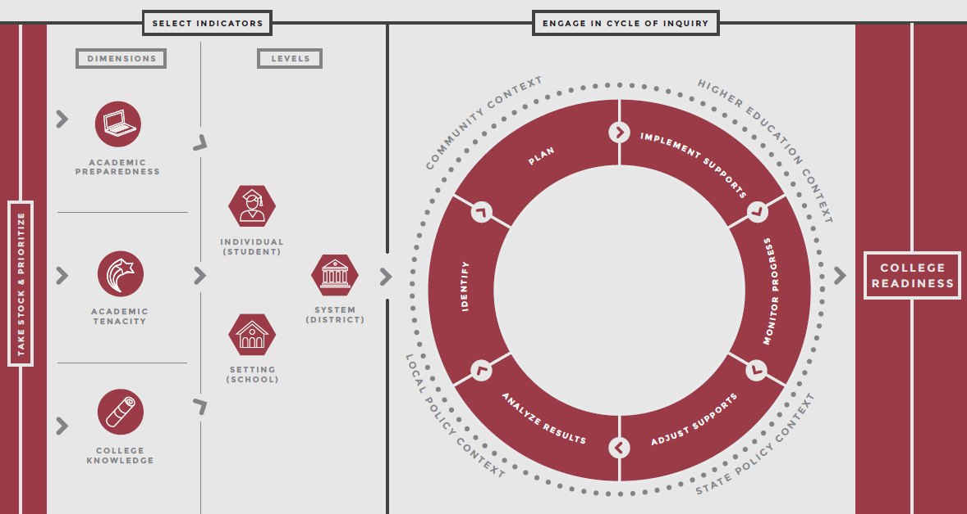
CRIS Framework

Slide 14
CRIS Framework in Action
Dallas ISD identified CR indicators based on analyses of 75,000 graduates 1998-2003
Based initial 2009 CRIS model on CCSR, AISR, Conley/EPIC work
Significant relationships indicated between HS data and future college enrollment and completion (NSC data)
GPA, exposure to rigor (AP; grad plan; magnet enrollment); ACT and SAT scores; age at HS graduation; gender; and ethnicity
College grads: ACT = 19.6; SAT = 973
Develop baseline data to determine effects of change
1998 to 2003: 15% of high school graduates completed college
Class of 2007: 19% of high school graduates completed college
Communicate outputs and outcomes

Slide 15
Middle School CRIS Indicators
Middle School Teacher Focus Groups
Funded by Bill and Melinda Gates Foundation CRIS II grant (Dallas and San Jose)
Four middle schools meet with Dallas ISD staff to pilot use of MS CRIS Indicators (Quintanilla, Edison, Stockard, and Richards)
Convert Dropout Early Warning System (DEWS) to CRIS for grades 6-12
Housed in MyData Portal for easy access
Same as CRIS High School Indicators
Grades
Course Failures
Attendance
Disciplinary

Slide 16
Middle School Prepares for College-Level Work
Advanced Academics
Nearly 19,000 AP exams taken in 2014 in Dallas ISD high schools
Prepare in Middle School with high school credit/pre-AP/MYP
Dual Credit course enrollment continues to rise
Dallas ISD starts new “National Merit” cohort of 7th to 10th graders to receive special enrichment and test prep programs
Reactivate Duke TIP program for top 5% of 7th and 8th graders
Access to TexPREP and other middle-high school advanced programs

Slide 17
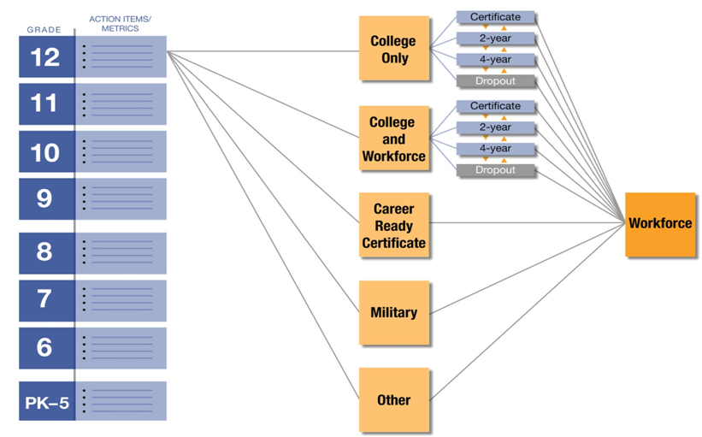
College To Career System

Slide 18
Middle School Prepares for Career-Level Work
House Bill 5: Focus on College to Career
Texas House Bill 5 supports aligned state data systems
Dallas ISD building data system with college and career outcomes
Endorsements
Selected by all 9th grade students
Five Endorsement Areas
STEM (including CTE)
Business and Industry (all CTE)
Public Services (including CTE)
Arts and Humanities
Multidisciplinary Studies (including CTE)

Slide 19
Texas Endorsements
STEM (Algebra II, Chemistry and Physics required for ALL STEM Endorsements) | BUSINESS and INDUSTRY | PUBLIC SERVICES | ARTS and HUMANITIES | MULTI-DISCIPLINARY STUDIES
Five Options to earn a STEM Endorsement: CTE Career Clusters Computer Science Mathematics Science Cross-Curricular | Database Management; Information Technology; Communications; Accounting; Finance; Marketing; Graphic Design; Architecture; Construction; Welding; Logistics; Automotive Technology; Agricultural Science; and Heating, Ventilation, and Air Conditioning (HVAC); Culinary Arts and Hospitality | Health Sciences and occupations; Education and Training; Law Enforcement | Political Science; World Languages; Cultural Studies; English Literature; History; and Fine and Performing Arts | Students select courses from the curriculum of each of the other endorsement areas and earn credits in a variety of advanced courses from multiple content areas sufficient to complete the distinguished level of achievement

Slide 20
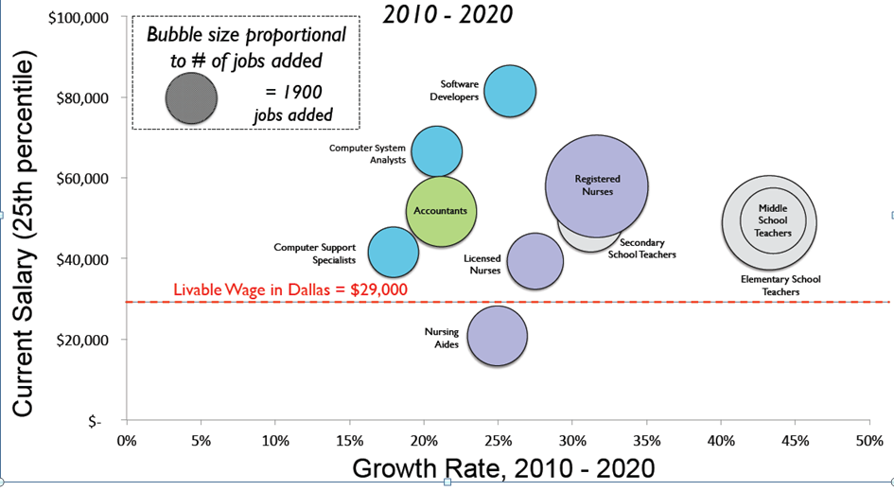
Must Plan Career Ladders with Regional Partners…and Align with Colleges

Slide 21
Small Group Activity
Break up in small groups of 4 to 6
Define “college”
Try to agree on one definition per small group
If that is not possible, then more than one definition is acceptable

Slide 22
System Challenges
Need clear definitions to create data systems
College defined by personal experience…years ago
“Four-year only” definition understood by K-12 teachers who had to complete four-year degree to teach
Public Policy Definition: “College” is any postsecondary education or training leading to a credential, license, or degree that allows for future advancement
Elitism: “College is not for everyone”
Believed to be true by Dallas low-income, minority students—and their families and friends—anecdotal evidence only
Focus on and fund programs to support “our successful” kids who become “symbols of success” for others…instead of adequately funding support programs for the “others”

Slide 23
System Challenges
K-12 systems support high school completion…only
K-12 system based on belief that high school completion = college readiness
Texas “college readiness” measures (too high) ≠ actual college completion data
American public education goals and goals of lifelong learning not explicit nor aligned
Workforce development “or” self-actualization…instead of “and”

Slide 24
The CRIS Resource Series
A New Framework for Promoting College Readiness
A description of the interrelated components that make up a college readiness indicator system.
Menu of College Readiness Indicators and Supports
A list of research-based indicators and supports to choose from in building an indicator system, organized across the three dimensions and three levels.
Selecting Effective Indicators
A guide for determining which indicators to include in data reporting systems in light of a district’s priorities and capacity to provide interventions and support.
A Technical Guide to College Readiness Indicators
A guide that outlines seven steps to examine the predictive validity of indicators.
Notes:
NOTE: ANOTHER CLOSE CALL. ONE THOUGHT WOULD BE TO ASK OUR CO-PRESENTERS TO ADD SLIDES FOLLOWING OUR LESSONS LEARNED, THEN ADD THE EXERCISE AND HOLD THE RESOURCE SERIES SPECS TO THE END. MIGHT BE A DECENT WAY TO CLOSE OUT THE SESSION.
***
I’ll close with the menu of seven core tools produced by the CRIS partners
Framework
Menu – fully populated edition of the 3x3 frame I walked you through earlier
Two technical guides – help districts select indicators and how to test predictive validity of an indicator

Slide 25
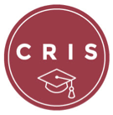
The CRIS Resource Series (cont.)
Essential Elements in Implementation
A report of key components of a CRIS, promising implementation strategies and case examples from the sites.
District Self-Assessment Tool
A tool that supports a district’s effort to assess and strengthen its organizational capacity to plan and implement a college readiness indicator system.
CRIS Online Framework
http://collegeready.gatesfoundation.org/Learning/CollegeReadinessIndicatorSystems
The online framework guides districts through the stages of developing an indicator system, helps them conceptualize what is necessary at each step, and connects them to the most relevant resources in the CRIS series.
Notes:
Two planning and diagnostic tools we hope get a lot of attention in the field
Essential elements of implementation
Assessment tool for a district to estimate its current level of capacity for college and career readiness
Finally, Gates commissioned a web design firm to render the CRIS into a on-line interactive tool

Slide 26
Contact Information
Angela N. Romans
Annenberg Institute for School Reform angela_romans@brown.edu
Linda K. Johnson
Dallas ISD College and Career Readiness lindjohnson@dallasisd.org
www.annenberginstitute.org/cris
www.dallasisd.org

