Slide 1
Building a Multi-Tiered Student Support System
The Middle School Matters Fall Summit
Robert Balfanz and Ben Reyes
October, 2014

Slide 2
Good Early Warning Systems Combine Accurate and Useful Indicators with Effective Multi-Tiered Student Supports

Slide 3
ABC’s of Secondary School Success
Early Indicator | On Path to Dropping Out | On Path to College Ready
Attendance | Miss 20 or more days- 10% | Miss 5 or Fewer
Behavior | Multiple Suspensions Sustained Mild Misbehavior | Have Self-Management, Regulation, and Advocacy Skills High on Hope
Course Performance | F’s and D’s (Failure often driven by not completing/turning in assignments) | B average

Slide 4
Why We Need Multi-Tiered Student Support Systems
Effective interventions are essential, but we can not intervene our way to a stronger system.
Once a student has an off-track indicator—you either need to solve a problem or change a behavior. This requires a strong relationship between an adult and the student.
If there are more students in need than adults to form strong relationships, you are in trouble.

Slide 5
What do We Know About Multi-Tiered Student Support Systems

Slide 6
Effective Student Support Systems Combine:
Ready access, at the classroom level, to on- and off-track indicators (the ABCs);
Regular time to analyze the data, pool adult knowledge about students, and leverage existing adult-teacher relationships; and
An organized response system that can act upon early warning data in both a systematic and tailored manner.
Notes:
In order to function well and at the scale needed multi-tiered student support systems need to have ready access to the early warning indicator data at the classroom level. Second, there needs to be a set time when adults can review the data and those adults who know the student can pool their knowledge and determine who currently might be best positioned to talk with and support the student. Finally, the system needs to be able to intervene both at the individual student level in a very customized way and also intervene more broadly at classroom, grade, and school level.

Slide 7
Effective Student Support Systems Combine:
Tier 1 - evidence-based whole school/classroom prevention for the ABCs (attendance, behavior and effort, course performance)
Tier 2 - targeted problem-solving and moderate intensity supports when prevention does not work
Tier 3 - case managed high-intensity supports for the neediest students
Notes:
It is important to practice intervention discipline and not always go first to the highest intensity intervention. They should be save for the students for whom neither prevention nor more moderate Tier 2 strategies work or students who clearly are in crisis.

Slide 8
Multi-Tiered Student Support System
Intensive One on One Supports:
Driven by needs assessment
Case managed
Professionally provided when whole school and moderate intensity supports are not sufficient
Extra-Supports Provided:
At first sign of student need
To all students who need it (no triage)
Diagnostic tools insure it’s the right support (e.g. cognitive or socio-emotional)
Moderate intensity but if needed continuously available
Intensity of interventions
Whole School is Organized and Supported to Enable:
Effective instruction (including teacher professional development connected to the early warning indicators)
Safe and positive learning climate
High student engagement (Attend, Behave, Try Hard)
Collective efficacy and all graduate mission among staff
Notes:
8
This slide aims to describe in more detail the key characteristics of each level of the multi-tiered student support system. It also graphically tries to show how each level of support wraps around and supports the next tier.

Slide 9
Using a Multi-Tiered Student Support System
Practice intervention discipline. Do not go first to the highest intensity intervention.
Use knowledge of your school and students when choosing interventions (one size does not fit all).
Assign adult champion with a relationship with student to make sure targeted or intensive intervention occurs.
Track outcomes of interventions on a regular basis.
Notes:
After the adults who know they student pool their knowledge and determine an intervention or course of action it is important to appoint someone who has a good relationship with the student to be the champion for the intervention or course of action to make sure it is implemented. It is also important to take the extra minute needed to formally record what intervention or course of action has been taken so it will be possible over time to learn which interventions are working for what types of students under what circumstances.

Slide 10
Multi-Tiered Student Supports More Advanced Work
Have diagnostic tools to deduce if student behavior is driven by academic, socio-emotional needs or both.
Look for and act upon patterns that emerge from the data—what is the most effective and strategic level of intervention—student, classroom, or school?
Use additional data to tailor interventions—Are most students failing overage? ELL? From just one or two classrooms?
Notes:
Advanced EWS work goes in two directions. One direction seeks to gain deeper understanding into the root causes of student behavior. The other direction is to look beyond the individual student to see if patterns emerge for groups of students that can help direct interventions to more strategic levels i.e. the classroom, grade, school, or even district.

Slide 11
Whole Group Activity
Look at the Early Warning Indicator data at your table. What patterns do you see? What might be the most strategic level of intervention?

Slide 12
Effective School-wide and targeted Student Support Actions

Slide 13
Focus on the ABCs - Attendance
Schools and communities need to measure and act on chronic absenteeism—the number of students who miss 10% or more of school (i.e. a month or more of school). They also need to measure those who miss a week or less.
Organize comprehensive efforts base on fact that student absenteeism is driven by combination of factors, including student choice, avoiding in-school challenges, and out-of-school issues pulling them away.
Notes:
Many schools and districts do not measure chronic absenteeism. They only measure average daily attendance. But it is possible for a school to have over 90 percent average daily attendance and for a quarter of students to be chronically absent, as different students are absent on different days. Students miss school for three broad reasons-1) something is keeping them out of school i.e. sibling care, elder care, the need to work etc, 2) they are avoiding something at school-safety concerns, bullying, teachers they think are mean etc. and 3) the make the decision that they can manage their work and do ok and miss a day every know and again or just decide its not worth getting up, traveling in bad weather, or being late. Each of these sets of reasons requires a different response and that is why its important to learn the reasons behind student’s actions.

Slide 14
Focus on ABCs - Attendance
Create programming that compels students to come to school, e.g., most-engaged secondary students often found in cognitively rich activities that combine teamwork with performance (robotics, debate, drama, chess etc.)
Build an attendance problem-solving capacity into schools and districts. Extend this via relationships with wraparound service providers and organizations that can provide additional adults during the school day to serve as “Success Mentors.”
Notes:
Some adults may believe that it is not the role of schools to encourage students to attend that it is up to the students themselves and their parents to understand the value of schooling and do what it takes to attend regularly. The challenge is, that when chronic absenteeism is significant it impacts the whole school including the students who attend everyday. Thus for the best interests of the school and all its students it is important for the adults in the school to put forth efforts to decrease chronic absenteeism.

Slide 15
Some Simple Ideas That Have Worked
Write a Plan-ask student to write with some detail what it would take to miss only 1 day of school next month.
Keeping up with the Jones-show students the attendance records of students who have recently graduated and succeeded in college.
What a day here and there can add up to-show students how many months/years of school they will miss if current attendance pattern continues.

Slide 16
More Simple Ideas That Have Worked
Happy to see you today — make sure that whenever a student returns from being absent someone says “Happy to see you” (without judgment or tone in their voice).
Being in school helps others — consistent recognition for collective improvement and reaching attendance goals.
Follow the peer leader — organize students to measure, monitor, and act.

Slide 17
An Important Mitigation Strategy
It’s the assignments — to mitigate impact of Chronic Absenteeism need system that makes sure Chronically Absent students get their assignments done.

Slide 18
Poor Attendance Often Drives Course Failure
Attendance is eight times (8x) more predictive of course failure than prior test scores.
Source: Chicago Consortium of School Research
Notes:
Many students who fail courses have poor attendance. As a result poor attendance rather than lack of understanding is more likely to be the root of poor course performance. In particular, students who are absent are much less likely to complete their course assignments.

Slide 19
Focus on ABCs - Course Performance
Provide course coaching, support, and on occasion, even advocacy, which enables students to succeed in their courses. This should include monitoring assignment completion, preparation for tests and quizzes, and helping students catch up when absent.
Make sure tutoring efforts are linked tightly with needs and expectations of student’s courses (don’t work on fractions during a tutoring session on Thursday if Friday’s test is on probability).
Need effective second chance and credit recovery programs that hold students accountable but provide a reason for them to keep trying.
Notes:
The typical reason students fail courses is that they do not complete their assignments. Systems need to be put in place to track assignment completion and provide supports for students who need them to complete assignments. There needs to be strong coordination between extra help provided to students to by non-profits or after school programs and what is occurring in student’s classes. The extra help being provided will be much more effective if its linked to on-going assignments and assessments.

Slide 20
4 Diagnostic Questions About Students Who Are Failing Courses
Are they regularly attending school? If not, why not?
Are they able to focus on schoolwork in school?
Are they productively persistent, i.e. trying in an effective manner?
Do they connect school effort to life success?
Notes:
These are some examples of the type of questions which can be asked to gain deeper understanding into the root cause of student course failures.

Slide 21
Focus on ABCs - Behavior and Effort
Model and teach resiliency and self-management and organization skills.
Implement school-wide positive behavior support programs and alternatives to suspensions.
Work to insure that students experience consistent academic and behavioral norms as they travel from class to hall and class again.
Build Success Scripts in students’ heads (effort leads to success), work to undermine Failure Scripts (success is capricious, withholding effort keeps you psychologically safe).
Notes:
Each of these bullets is important. Since all students in the 21st century need to graduate prepared for post-secondary schooling or training, we need to directly teach them the skills they need to organize and manage their schoolwork and to help them strengthen their ability to bounce back from challenges. Second, the evidence shows it is not possible to suspend your way to a better school climate, it must be built directly and a key part of this is recognizing and modeling good behavior. Third, school for students is the series of classrooms they travel through in day. If they encounter very different academic and behavioral expectations from class to class, then everything becomes personnel-and students adjust their behavior accordingly from class to class. . If they encounter similar expectations classroom to classroom they learn that this is how one acts and behaves in school. Finally, it is important to provide students with avenues to learn that effort leads to success. This is particularly important for students who enter the school with a prior history of course failure.

Slide 22
A Deeper Strategy
Build Up Hope and Purpose—students need to have a reason to come everyday, try hard, and behave.

Slide 23
Gallup annually surveys hundreds of thousands of 5th to 12th grade students about their hope, engagement, and well-being. What have they found?

Slide 24
Hope
Hope involves taking positive thoughts about the future, putting lots of resources and hard work behind them, and gauging your progress until it happens.
Hope drives attendance, credits earned, and GPA in high school.
Hope varies by place not by grade. Those who feel the most hopeless are the lowest income male students in cities with high inequality and low social mobility.
Students are generally confident in their future but lack necessary strategies to reach big goals of graduation and employment.
46% are not confident they can find many ways to get good grades.

Slide 25
Engagement
Engagement varies by grade. It is high in elementary school and declines through the middle grades and early high school years.
Decline directly linked to student’s perceptions about the value placed on good schoolwork. 74% of 5th graders said “In the last 7 days I have received recognition or praise for doing good schoolwork.” Compared to only 31% of 9th graders.
Also sharp decline between 5th and 8th grade in “My teachers make me feel that my schoolwork is important.”
Students also report significant decline in how frequently teachers make them feel excited about the future.

Slide 26
Engagement
Students who strongly agree that their school is committed to building their strengths and that they have a teacher who makes them excited about their future are almost 30 times as likely to be engaged learners as their peers who strongly disagree

Slide 27
Well Being
 | 5th Grade | 8th Grade | 12th Grade
Were you treated with respect all day yesterday? | 75% | 65% | 68%
Did you learn something interesting yesterday? | 82% | 73% | 71%
Did you have enough energy to get things done yesterday? | 85% | 75% | 60%

Slide 28
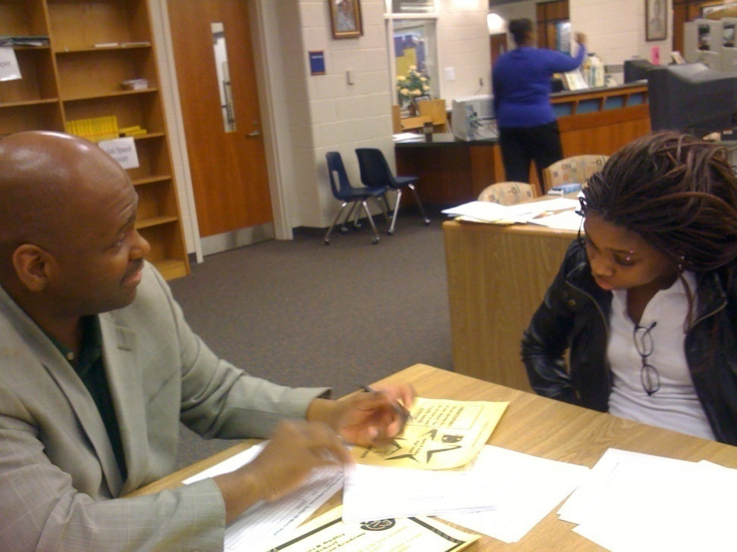
Report Card Conferences
The belief is that talking to a trusted but objective adult takes the emotion out of the process and helps students focus on what's really holding them back.
Greg Toppo, USA TODAY
12/4/2006
Notes:
Report card conferences can be a valuable prevention and intervention strategy. The basic idea is that when students receive report cards they have a conversation with an adult who is not their teacher about their report card. The adults are provided with a protocol . They commend students for good work, inquire about what can be done to bring up low grades, and have several pre-set courses of action they can recommend to the student. Students who are failing are invited to take a recovery contract to their teacher.

Slide 29
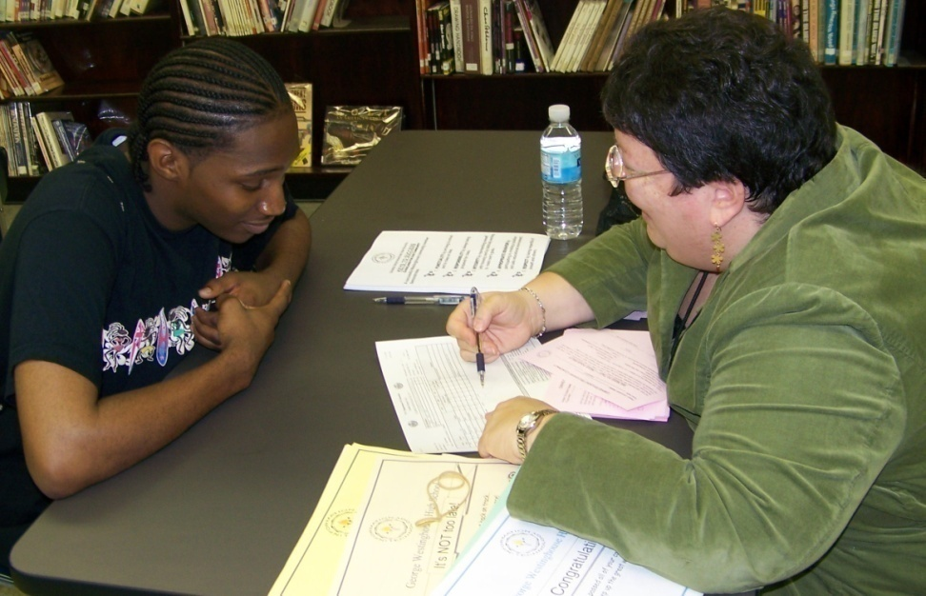
Student Feedback
“I feel like I still have a chance now; when I came in I wanted to throw my report card away.”
“I didn’t know the word ‘advocate’ before I met that lady, but I will speak up for myself now.”
“Somebody actually cares about me. I hope I get to talk to him again next time.”

Slide 30
Our Design Brief
Pool our insights, knowledge and experiences to understand what school structures, strategies and adult efforts can create the conditions needed to develop productive persistence, hope, engagement, and well-being among adolescents who live in high-poverty environments and how this can be translated into better attendance, better behavior and effort, and better grades.

Slide 31
What Student Strengths Can we Build Upon?
Take a minute to brainstorm with your table.

Slide 32
Take Away Challenge
Use the three tiered grid and its questions about need, capacity, and effectiveness to evaluate and improve the multi-tiered student support system in your school/district.

Slide 33
For more information
Visit the Everyone Graduates Center at www.every1graduates.org
For this and additional PowerPoints presented during Middle School Matters, please visit
www.every1graduates.org/bushinstitute2014

